Slide 1
R Session 6
Ln(likelihood ratio), formal tests for likelihood models, logistic regression

Slide 2
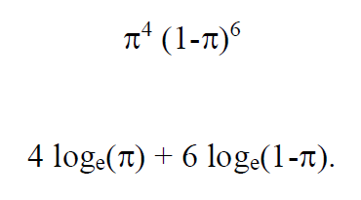
Logs Reminder

Slide 3
How is this useful?
Remember making the likelihood ratio to obtain relative estimates of likelihood for your model?
Computers don’t like dividing and multiplying numbers in complex models.
Logistic regression is a multiplicative modelling technique at base
Addition on the ln(odds) and ln(likelihood) is the same as multiplication
It’s therefore easier to use the natural log of likelihoods and odds, this also helps avoid impossible values for the risk and rate parameters.

Slide 4

Practical
Using your ‘4F 6S’ likelihood model from last session use ‘mutate’ to create a variable for the log likelihood in the model.
i.e. create a variable for this equation where 4 and 6 are the ‘died’ and ‘surv’ in the precursor variables for your model
Plot the log likelihood against the parameter using ggplot2
What do you see
Looks really unhappy because what would the likelihood be when those values equal 1 and 0?

Slide 5

Practical 2
What you’ve got is some asymptotes
You can remove them using +xlim(left, right) and ylim(top, bottom) to set the scales on the x and y axes respectively
Play around with the scales to get a good idea of the likelihood ratio distribution
Set a hline for ln(0.1465) for the supported range of your model (see last time)

Slide 6
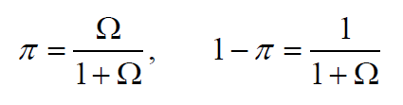
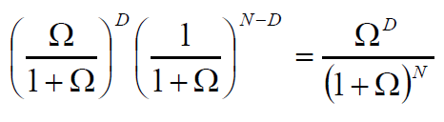
Moving from risks to odds
It can be shown that risk relates to odds in the following equations, and these can just be substituted in to the general model equation to find a likelihood

Slide 7



Getting a corresponding log odds likelihood
The most likely value of ODDS is D/(N-D) and reducing the model is:
We know the likelihood for a Gaussian distribution is
So the corresponding log likelihood is

Slide 8
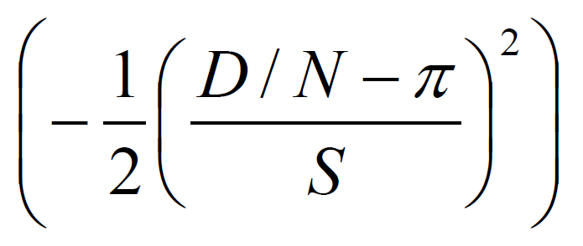
QUADRATIC EQUATIONS
We saw how finding the exact values of pi which are equal to a likelihood ratio of 0.1465 is actually really difficult, as you have to find them by trial and error using the likelihood methods described, using ever finer values of pi.
The shapes of these curves are approximately quadratic, therefore approximately gaussian
So we can find answers for the approximate supported range by approximating pi into a gaussian log likelihood ratio distribution in the form:

Slide 9
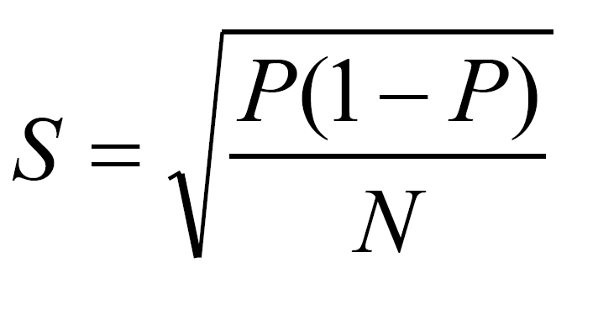
Practical
It can be shown that ‘S’ is equal to:
Where P is the same as (D/N)
(most likely pi)
Create a vector value for S
Create a new variable in your model for the approximate log likelihood ratio using the quadratic form.

Slide 10
Practical 2
Plot the approximate LLR against the ‘’true’’ LLR for pi and see how the approximate supported ranges are different
In the aes() for the different geom_lines() add a colour = “var” to add a legend to the right hand side of the graph
The title of the legend can be changed with + labs(colour = “title”)

Slide 11
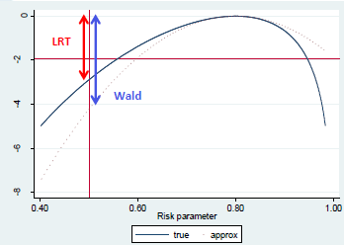
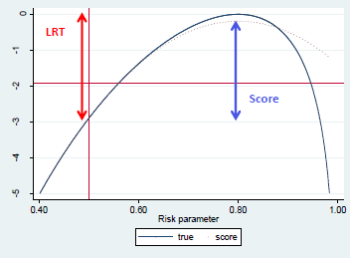
Approximations
Approximations can be used to find values for certain tests
These are the Score test and Wald Test
The Likelihood Ratio Test we talked briefly about last week uses exact values
The LRT also gives the exact same p value when working with risk or odds
But, with a reasonable amount of data all three give similar results

Slide 12
Back to odds and transforming parameters
Remember how we had problems with 0 and 1 for our model as they faded away into nil asymptotes – this is because the values of ln(pi) are restricted on both sides
LOG ODDS ARE NOT RESTRICTED AT ALL
Therefore to avoid impossible values of risk and rate we work in log rate and log odds
This requires new expressions for ‘S’ – see table at the end.
Addition on this scales translates to a multiplicative model

Slide 13

Using this in Logistic Regression
Reminder about odds ratios

Slide 14

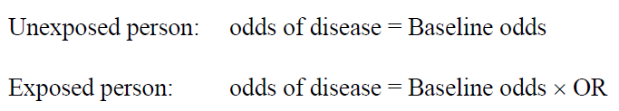
The most basic logistic regression model
Why log odds?
They can take ANY value between –inf and +inf
Normal odds can’t go lower than 0

Slide 15
Practical
Make a simple GLM between smok and lung_ca with a binomial distribution from the smok_dta we used a couple of weeks ago
Assign the glm() function to an object to save your model
Look at the coefficients using summary(model)

Slide 16
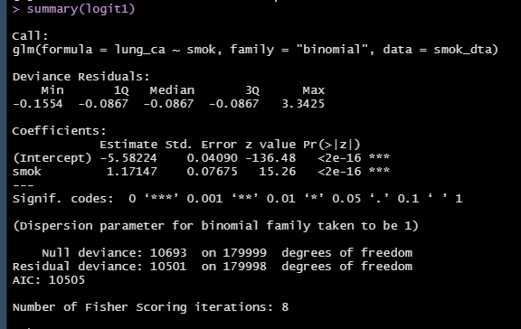





Output for basic logit model
Deviance of data from model predictions. Lower is better
Maximum Likelihood Estimates of parameters. (intercept) is the log odds in the baseline group, smok is the log(OR) of effect of that variable in the model
Wald Test p-values

Slide 17
Practical
We can take the log(OR) and log(Odds in unexposed) from the model output and put it back into our hand calculations
Log(Odds in exposed) = -5.58224 + 1.17147
To find the odds ratio you can exponentiate these coefficients using a calculator, or use exp(coef(model))

Slide 18

How to test this OR
You can take the Wald Test p-values, but that’s not always accurate as if you remember, it uses a gaussian estimation of the quadratic nature of your model
Better is to use the Likelihood Ratio Test – which in our models is based on the likelihood ratio statistic obtained from comparing two models, with and without the variable of interest.

Slide 19
Practical
Install the package “lmtest” and load it into the library
Test your model with one variable against the null using
Lrtest(model)
This tests the log likelihoods of the models and compares it on a chisq with the appropriate number of df to give a p-value
It tells you whether smoking is associated with lung cancer
Is it?

Slide 20
Practical
Build another model and assign it to an object
Use the same model as before but add in chem as a confounder
(lung_ca ~ smok + chem, …………)
Is this more complex model better at describing the data than the previous nested model?
Use lrtest(model1, model2) to get a p-value of whether this model better describes the data (the models are different)

Slide 21
Effect modification in Logistic Regression
It’s dangerously simple to model effect modification in logistic regression models
Quick reminder
EM is where 2 variable cause more of an effect together than independently
AKA – they have an extra effect above pure multiplicative effects
This means the model will have to try and take into account some modification above adding the logs together
You can do this by adding a * between your two ?interacting variables

Slide 22
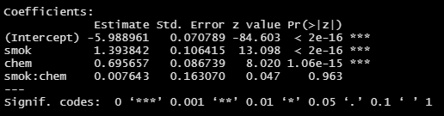
Practical
Make the same adjusted model but this time include an interaction term between smok and chem
Check the summary of this model
There’s a new coefficient!
smok:chem is the interaction component, the amount it departs from both smok and chem! The Wald test here is the actual statistical test of interaction!

Slide 23
Summary
Why are estimates used for statistical tests sometimes rather than true likelihood
Why do we use odds for logistic regression rather than risk, and why in the logarithmic scale
How do we build a logistic regression model in R
How do we add interaction terms to this model
How do we see whether the inclusion of variables changes the likelihood of the model (are these variables worth including?)

